Slide 1

Capstone Project Phase B 22-2-R-4 Authorship Recognition in Classical Religious Texts
Students: Yarden Adika, Noor Abu Abeid
Supervisors: Dr. Renata Avros, Prof. Zeev Volkovich

Slide 2
Presentation Overview
Introduction
Goal
Algorithm - solution
Algorithm Stages
Expected Achievements
Research Processes
Challenges
Results
Verification Plan

Slide 3
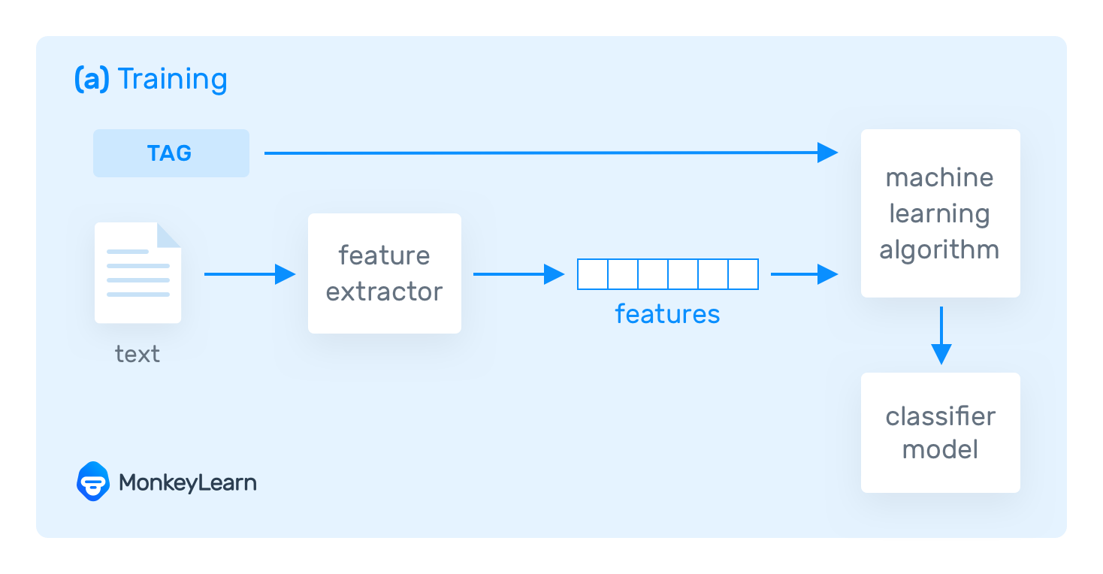
Introduction
What is text classification?
Text classification methods
Text classification examples:
Sentiment analysis
Spam detection in emails
Language detection
Notes:
Text classification is the process of assigning predefined categories or tags to a text based on its content. It is a supervised learning task, which means that the model is trained on a labeled dataset, where the text and its corresponding label are provided. The most common approach to text classification is using machine learning algorithms such as Naive Bayes, SVM, Neural Networks, etc.

Slide 4
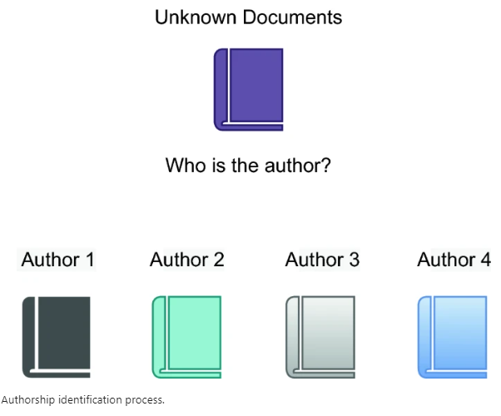
Goal
Authorship Attribution
To identify whether a particular text belongs to the Religious Texts of the Holy Koran or Bible - using deep learning techniques
Analyzing languages that have been less studied until now, such as Hebrew and Arabic
Notes:
Authorship attribution is the task of identifying the author of a given document.

Slide 5
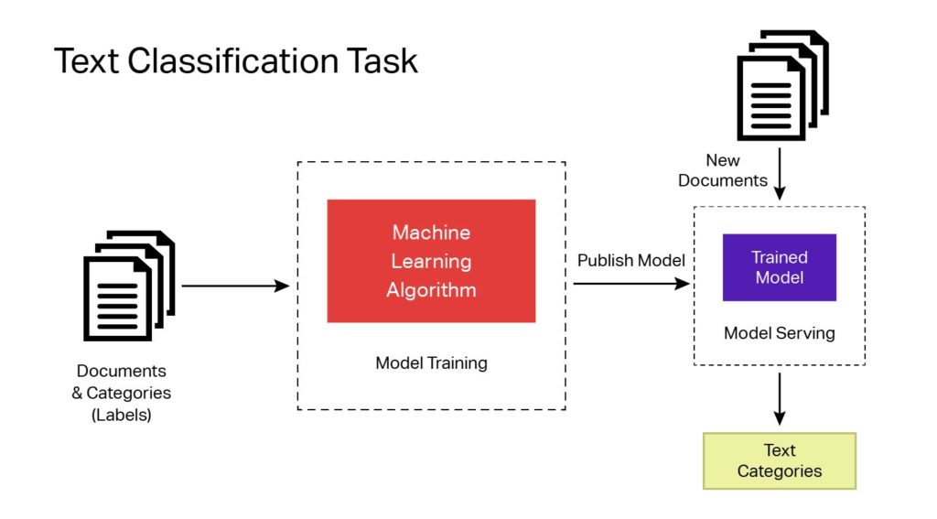
Algorithm - solution
Building a new model for text classification using deep-learning techniques
It involves word embedding, BERT Transformers (AraBert and HebBert), and CNN
Notes:
Authorship attribution is the task of identifying the author of a given document.

Slide 6
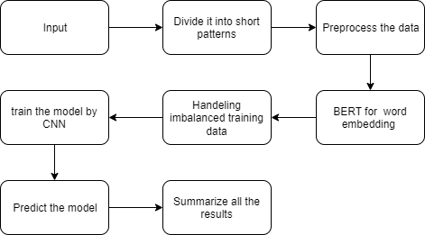
Algorithm Stages

Slide 7

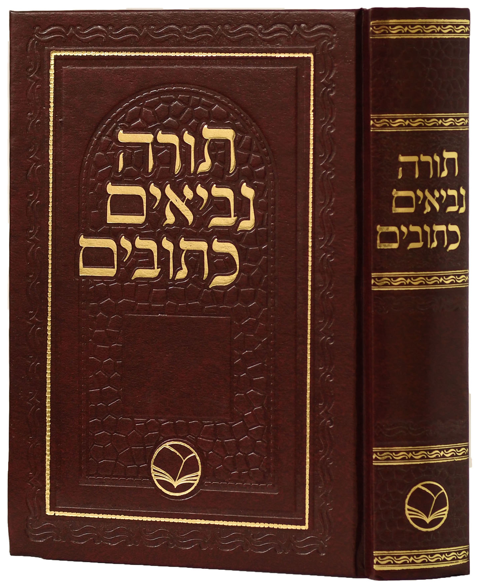
Data Set
The Bible book and imposters (books in the Hebrew language)
The Holy Koran book and imposters (books in the Arabic language)
The text to classify is a part of the Bible and the Holy Koran that wasn't included in the training data
Notes:
Authorship attribution is the task of identifying the author of a given document.

Slide 8
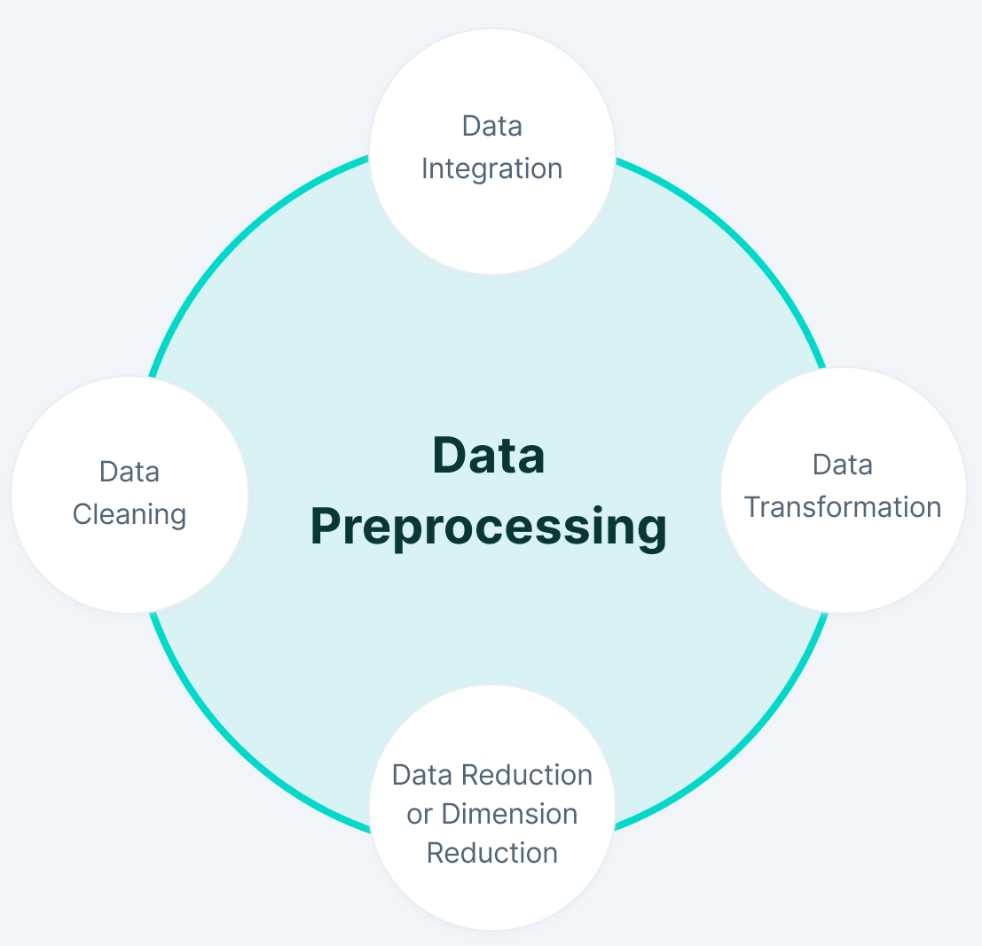
Data Preprocessing
Divide the texts into tokens
Convert to lowercase
Remove punctuation marks/tashkeel, special characters, and digits
Remove remaining tokens that are not alphabetic
Remove stop words
Remove Nan Values

Slide 9
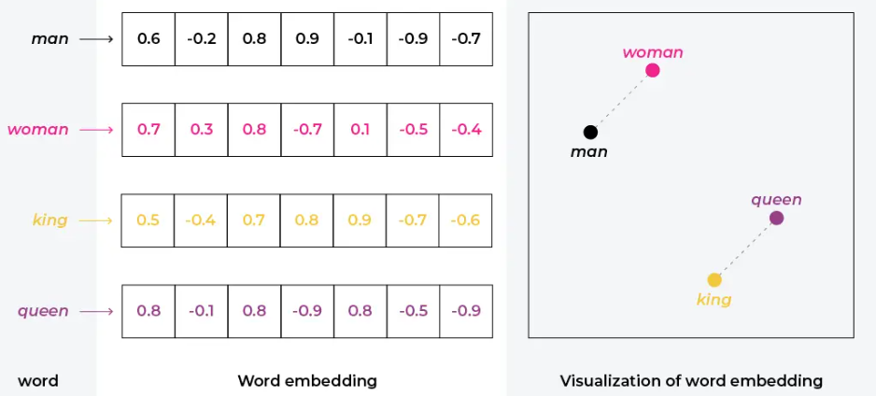
Word Embedding
Vector word representation provides similar embedding for two words with similar meanings
Improve the performance of deep learning models on challenging NLP (Natural Language Processing) problems
Contextual word embeddings:
BERT (AraBERT, HebBERT)

Slide 10
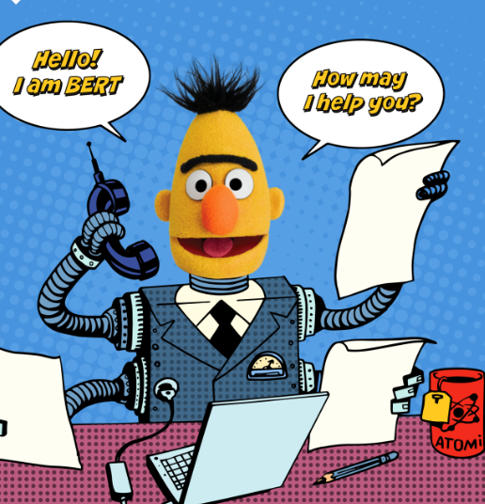
BERT (Bidirectional Encoder Representations from Transformers)
BERT is a transformer-based machine learning technique for natural languages processing (NLP) pre-training
Designed to pre-train unlabeled text by conditioning both left and right contexts in all layers
Every output element is connected to every input element, and the weightings between them are dynamically calculated based on their connection
Focus on two different NLP tasks:
Masked Language Modeling
Next Sentence Prediction

Slide 11
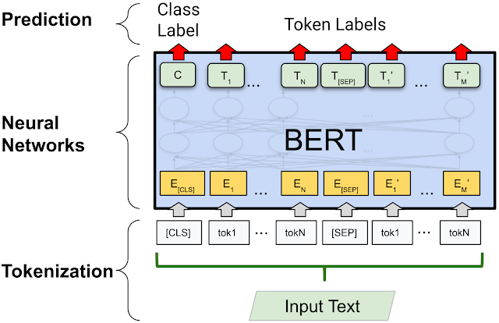
BERT

Slide 12

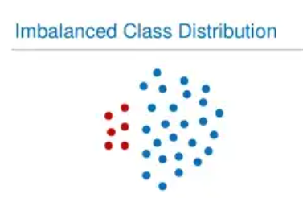
Balanced the data
Balanced dataset is a dataset with the same number of input samples representing each output class (or target class)
Imbalanced dataset has significantly more samples for one class than others
Balancing techniques:
Under-sampling
Over-sampling
Threshold
Notes:
In multi-classes (multi-label) classification,

Slide 13
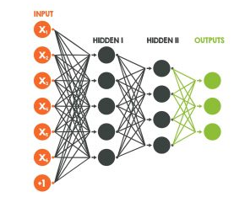
CNN
A Deep Learning methodology that can take in input such as text, audio, or picture and detect a specific feature in the input
The stages on CNN:
convolution layers
pooling layers – Max Pooling or Average Pooling
fully connected layers (flattening) – Linear, ReLU
activation function – Softmax Function or Sigmoid Function

Slide 14

CNN

Slide 15

The final process
Get imposters and divide them into short pieces like "tweets" these texts will be our training data
Preprocess the data
Word embedding by Bert
Balanced the data
Create the CNN model
Train the model
Predict the authorship of a new text by the model
Analyze the result and effectiveness of the algorithm
Summarizing the results

Slide 16

Expected Achievements
Our expectation in phase A was to comprehend religious text Structure more precisely. And the idea was to create a model that Identifies whether a particular text belongs to the Religious Texts of the Holy Koran or Bible
In phase B, we achieved our goal, and the model meets the expectations

Slide 17

Research Process
Understanding all the related materials and papers/articles
Finding data on the two languages
Choosing the programming language (python)
Choosing the related libraries
Choosing the most appropriate programming environment (Jupyter)
Determining the algorithm stages
Understanding how to implement each stage in the algorithm For example, the HebBert model
Notes:
For building the model..

Slide 18

Challenges
Finding articles and materials that could be used in the study
Working with less-studied languages such as Hebrew and Arabic
Finding books that can be used with the correct permissions for the imposters
Understanding how to work with the HebBert model and combine it with the rest of the program
Finding the right software to run the model
Spyder by anaconda
Google Colab
Jupyter

Slide 19
Verification Plan
During our programming stage, we tested ways to evaluate our model:
Accuracy value
Loss value
Accuracy and Loss graphs
“model.evaluate” function
Confusion Matrix

Slide 20
Verification Plan
Test Description | Expected Results
Check the path of the data folder | Show the labels of the data if correct and error if not
Check the preprocess | Remove the unnecessary characters (numbers, symbols, Tashkeel, punctuation)
Predict the author of the test file | Predict the correct author of the test file
Predict the author of the same test file a couple of times | The same authorship prediction
Predict whether the test file belongs to the holy books (Bible or Holy Koran) | The test file belongs to the holy books (Bible or Holy Koran)
Check the effect of changing the number of epochs on the training process | If it is too small, then the training won't be good, but if it is too high, then the training will be overfitted
Check the effect of changing the threshold size on the training data | If it is too high, then the training data will be too small, but if it is too small, then the gap between the labels will be too big

Slide 21
Results

Slide 22
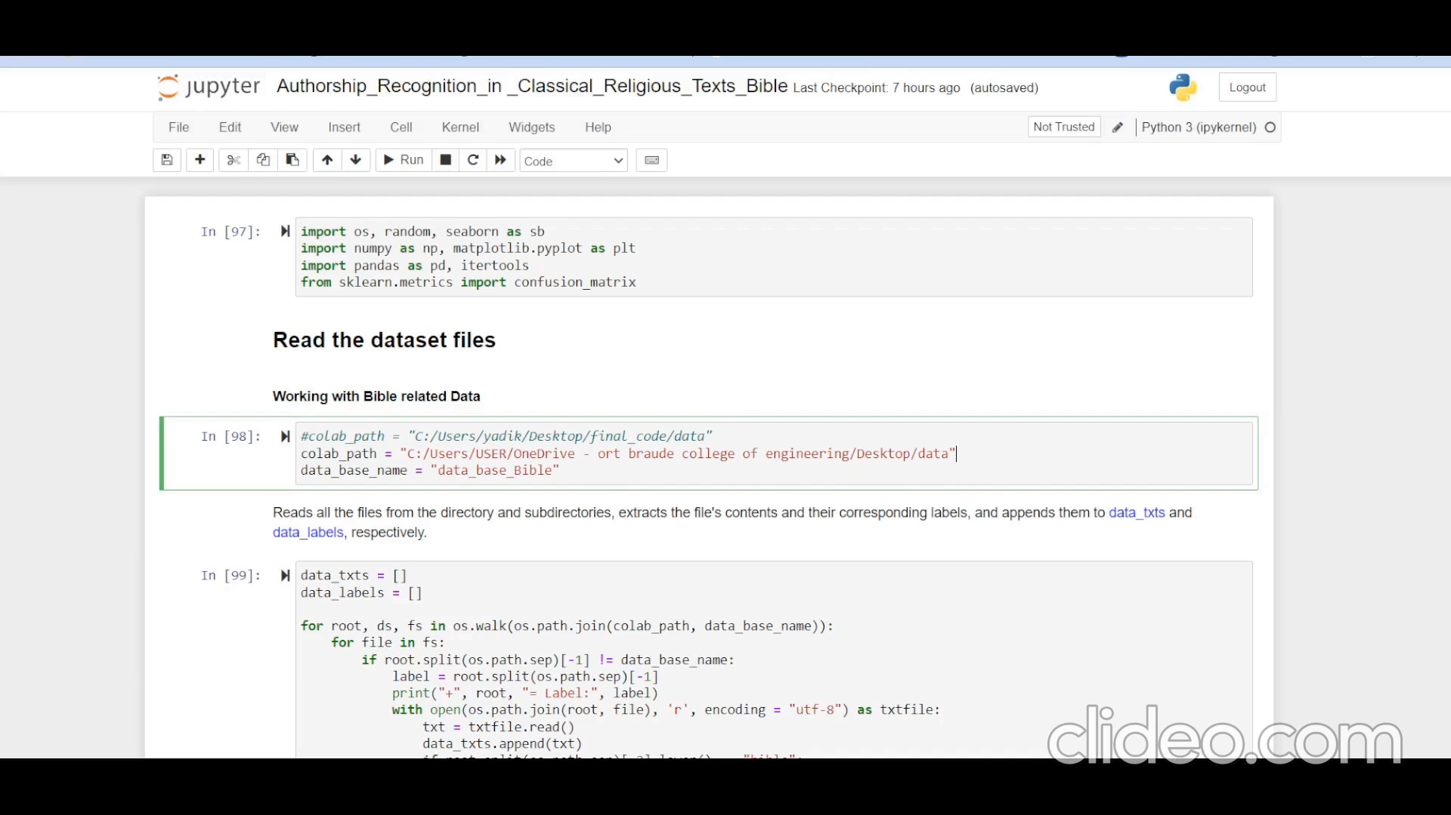

Slide 23
Thank you for listening!

